Slide 1
BIG DATA ANALYTICS
MINI PROJECT
CO2 Emissions(metric tons per capita)

Slide 2

CO₂ EMISSION
Carbon dioxide enters the atmosphere through burning fossil fuels, solid waste, trees and wood products, and also as a result of certain chemical reactions. Carbon dioxide is removed from the atmosphere when it is absorbed by plants as part of the biological carbon cycle.

Slide 3


TECHNOLOGIES USED
Hadoop Framework that allows for the distributed processing.
Hive data warehouse software facilitates reading, writing, and managing large datasets.
R studio open-source integrated development environment for R programming language
Tableau produces interactive data visualization products focused on business intelligence.
.

Slide 4
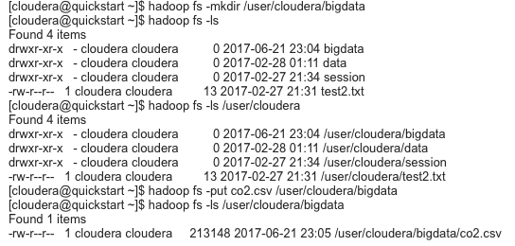
Hadoop:
Loaded the dataset into hadoop file system as a csv file.

Slide 5
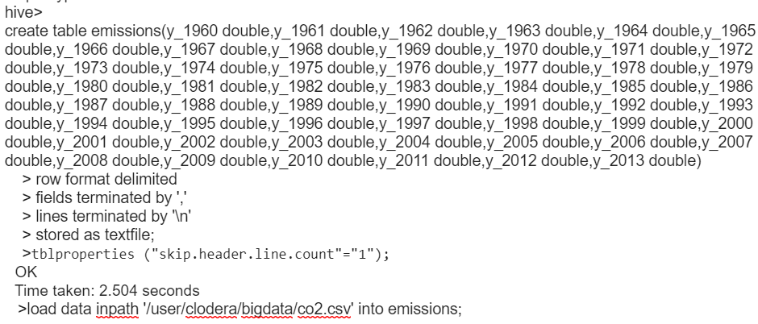
Hive:
Created a hive table named emissions with years as fields and loaded the csv data into the table.

Slide 6
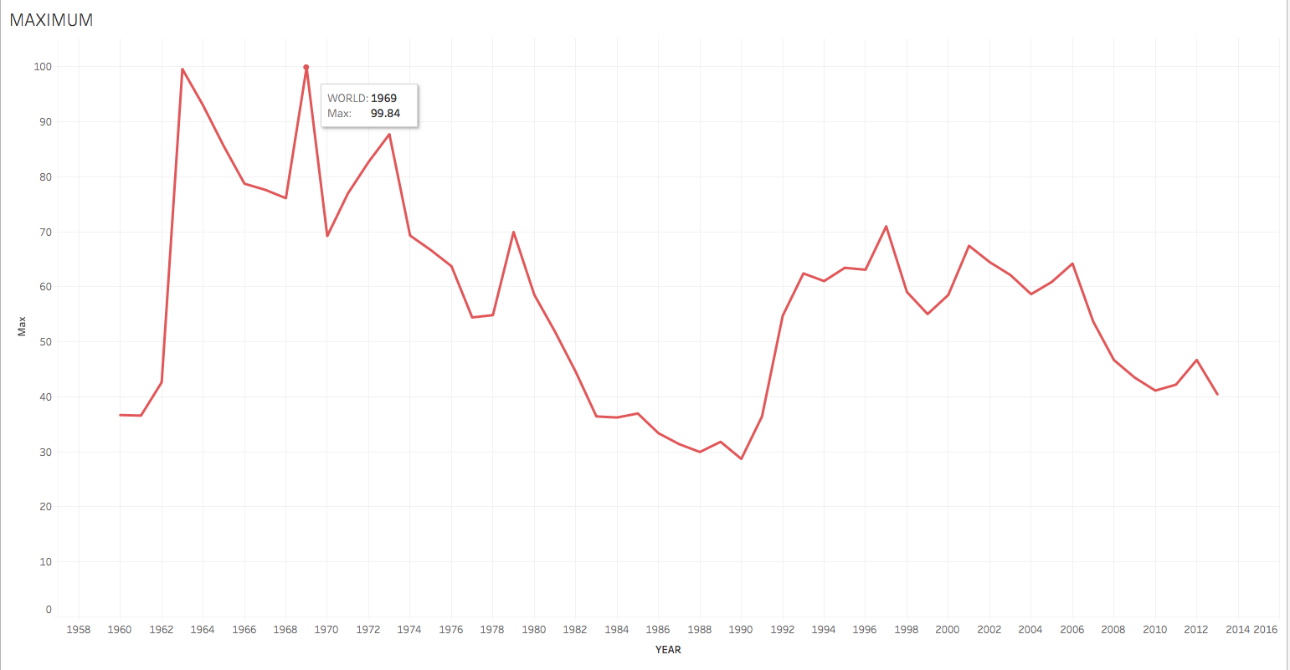
Tableau:
Maximum:
The maximum value for each year has been found using hive and its results are visualized using Tableau.

Slide 7
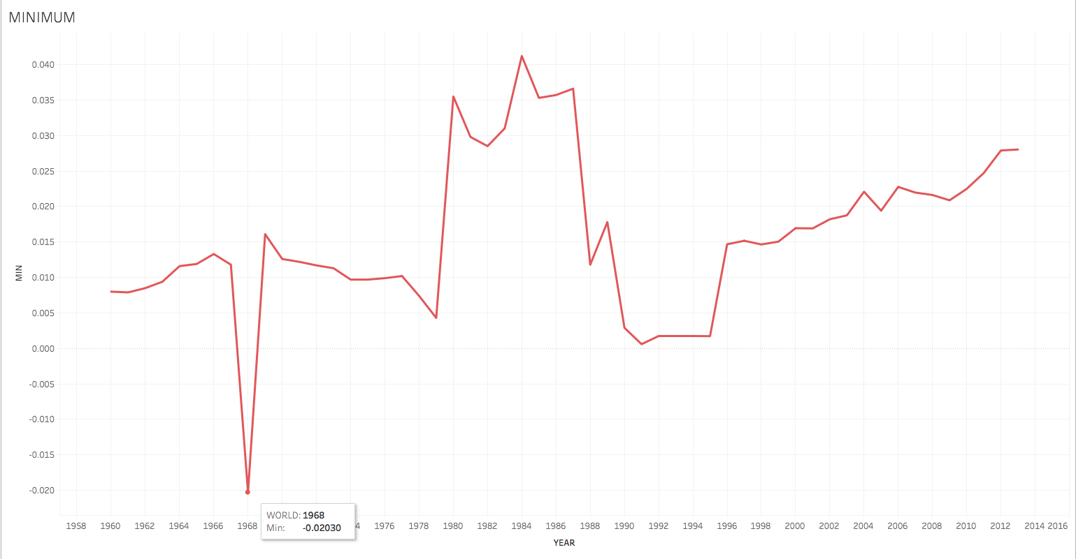
Minimum:
The minimum value for each year has been found using hive and its results are visualized using Tableau.

Slide 8
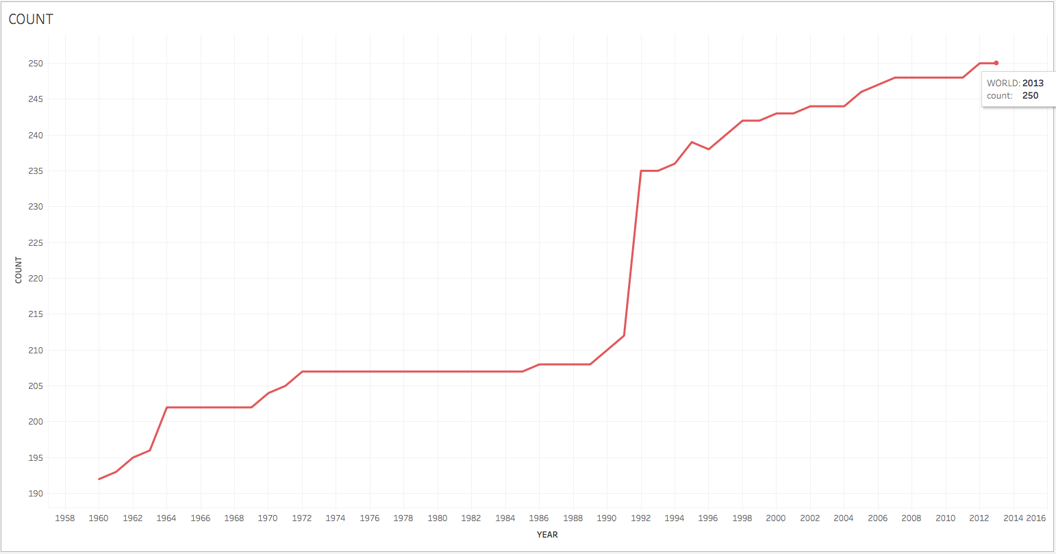
Count:
The number of values made for each year has been found using hive and its results are visualized using Tableau.

Slide 9
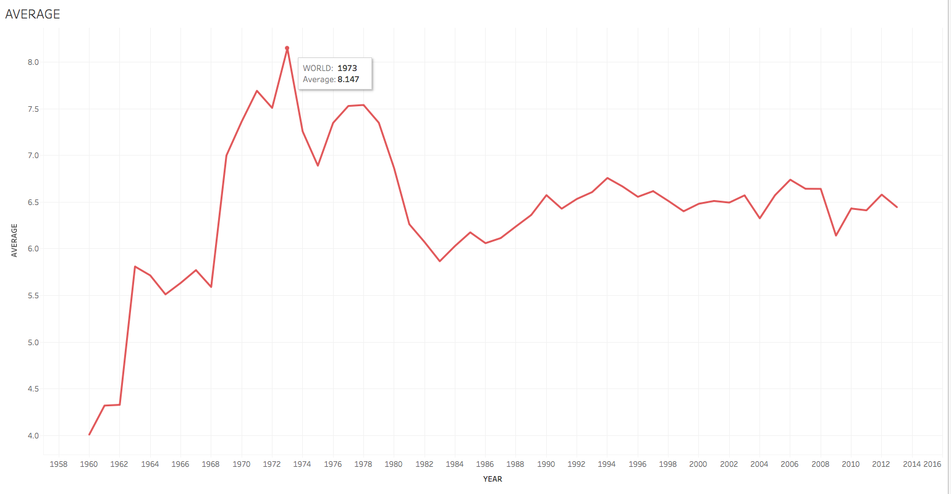
Average:
The average value for each year has been found using hive and its results are visualized using Tableau.

Slide 10
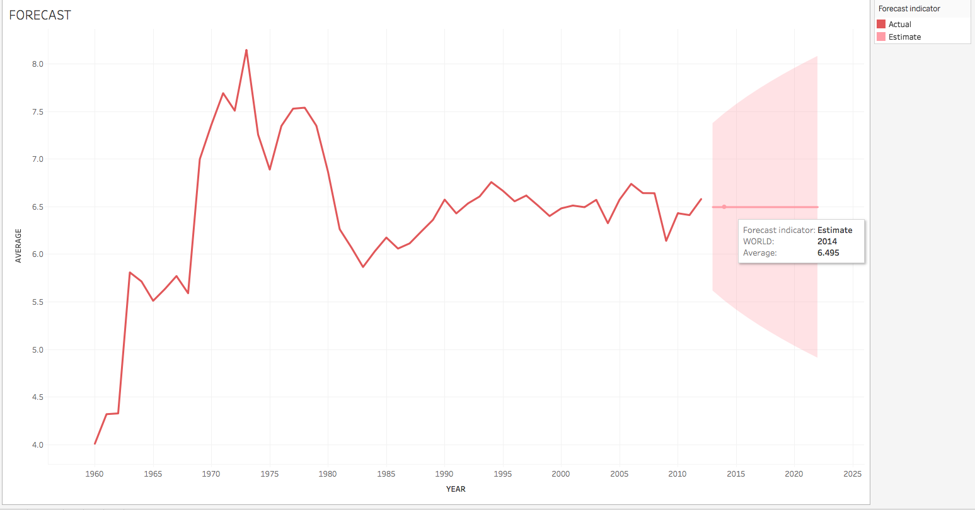
Forecast Analysis:
The future predictions are visualized through the analysis feature available in Tableau.

Slide 11
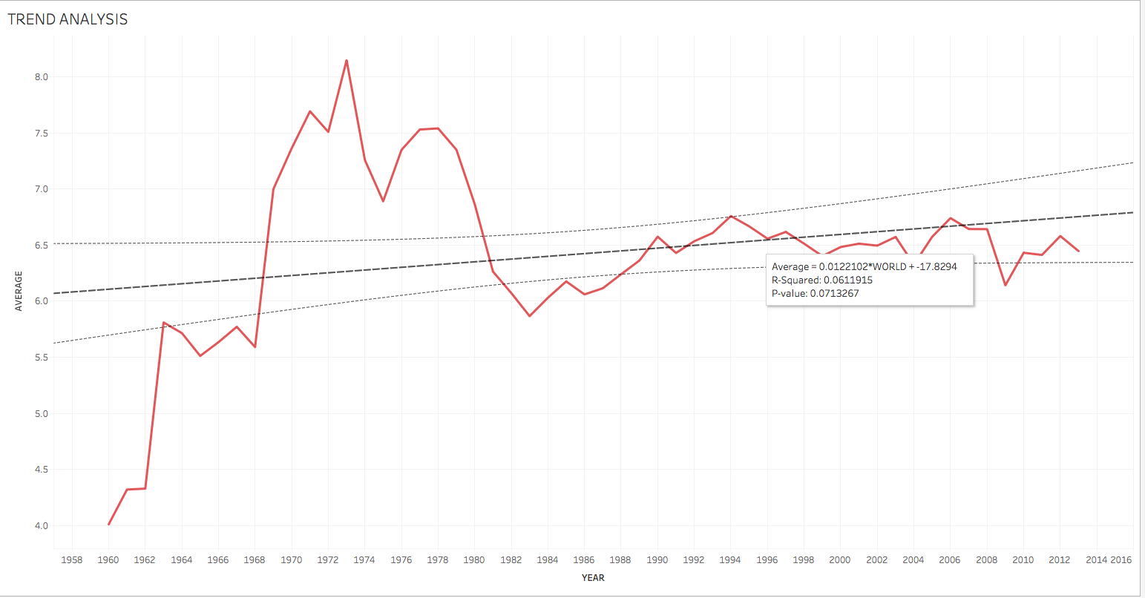
Trend Analysis:
The data trends using lines of best fit on statistical models are visualized through the trend analysis feature available in Tableau.

Slide 12
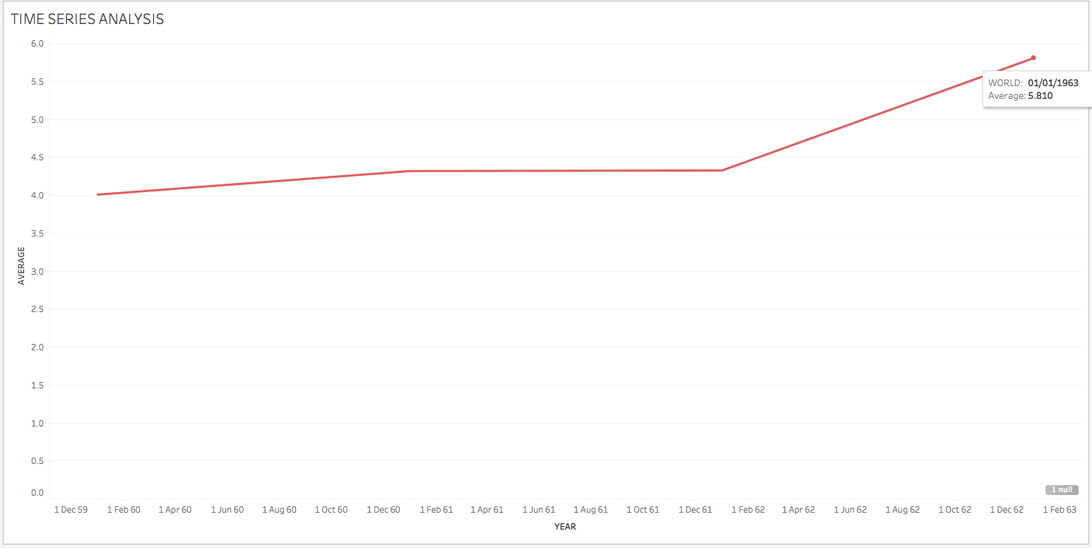
Time Series Analysis:
The month by month analysis of data are visualized through the built-in date and time feature available in Tableau.

Slide 13
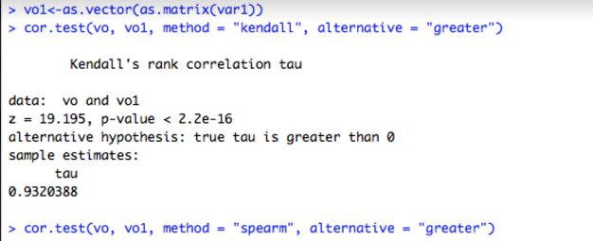
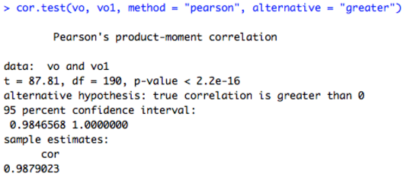
R studio:
Correlation between two variables:
The correlation between the year 1960 and 1961 is calculated through the cor.test() function in R studio.

Slide 14
Observations from the dataset:
On an average,the CO2 emission rate is found to be maximum during the year 1960 and minimum during the year 1973.
Based on the forecast analysis,the average emission rate for the upcoming years is found to be 6.495(metric tons per capita).
The Co2 emission rate is found to be maximum(99.84) in the United Arab Emirates during the year 1969.
The Co2 emission rate is found to be minimum(-0.020) in the country Senegal during the year 1968.

Slide 15

Real time big data application:
Big data drives success in manufacturing.
Rolls-Royce manufacturers

Slide 16
Rolls-Royce Manufacturers:
Rolls-Royce put Big Data processes to use in three key areas of their operations: design, manufacture and after-sales support.
Paul Stein, the company’s chief scientific officer, says: “We have huge clusters of high-power computing which are used in the design process. We generate tens of terabytes of data on each simulation of one of our jet engines. We then have to use some pretty sophisticated computer techniques to look into that massive dataset and visualize whether that particular product we’ve designed is good or bad.”
Rolls-Royce have been able to offer a new service model to clients, which they call Total Care, where customers are charged per hour for the us of their engines, with all of the servicing costs underwritten by Rolls-Royce.

Slide 17
THANK YOU!

